Slide 1

IS 507 - Data, Statistical Models
and Information
Group 4 – Marketing Campaign

Slide 2
Agenda
Team Members
1
Project Overview
2
Results and Discussion
3
Conclusion
AGENDA
4
Limitations
5
Future Scope
6
References
7

Slide 3

TEAM MEMBERS

Slide 4






Team Introduction
Bhanu Kurakula
Miloni Shah
Moksha Shah
Riyanshi Shah
Tanvi Lakhani

Slide 5
PROJECT OVERVIEW

Slide 6
INTRODUCTION
Dynamic Marketing Landscape
Tailoring campaigns to diverse customer preferences is crucial in the evolving marketing landscape.
Role of Customer Segmentation
Businesses recognize the pivotal role of customer segmentation in optimizing marketing strategies.
Optimized Product Development
Insights into customer needs and preferences guide product development, ensuring that offerings align with market demands.
Competitive Advantage
Businesses that understand their customers gain a competitive edge by anticipating market trends and staying ahead of competitors.
4

Slide 7
LITERATURE REVIEW
Customer Segmentation and Marketing Optimization
Hosseini, M., & Shabani, M. (2015). New approach to customer segmentation based on changes in customer value. Journal of Marketing Analytics, 3, 110-121.
Customer Behavior Analysis and Budget Optimization:
Gunnarsson, B. R., vanden Broucke, S., & De Weerdt, J. (2019). Optimizing marketing campaign targeting using uncertainty-based predictive modelling. 2019 International Conference on Data Mining Workshops (ICDMW).
Recency Trap and Dynamic Programming
Chang, C.-T., Chu, X.-Y. (Marcos), & Tsai, I.-T. (2020). How cause marketing campaign factors affect attitudes and purchase intention. Journal of Advertising Research, 61(1), 58– 77.
Customer Complaints and Service Impact
Blodgett, J. G., Wakefield, K. L., & Barnes, J. H. (1995). The effects of customer service on consumer complaining behavior. Journal of services Marketing, 9(4), 31-42.
Factors Influencing Campaign Acceptance
Sultan, F., Rohm, A. J., & Gao, T. (2009). Factors influencing consumer acceptance of mobile marketing: a two-country study of youth markets. Journal of Interactive Marketing, 23(4), 308-320

Slide 8
RESEARCH QUESTIONS
How can we use demography to understand our customers and shape our marketing strategies?
What targeted marketing strategies can be developed based on customer purchase patterns?
How do customers respond to our marketing campaigns, and what factors contribute to their acceptance?
What insights can we gain by understanding the details of the customers' last purchase?
In what ways do customer complaints impact the effectiveness of our campaigns?
1
2
3
4
5

Slide 9




METHODOLOGY
Data Cleaning & Exploratory Data analysis
Handling Imbalance using Over-sampling
Model training & Analysis
01
02
03
04
Encoding variables
Packages:
Kmodes | Pandas | Matplotlib
Stringr | Tidyr | Dplyr
Corrplot | Ggplot2 | gmodels2
R version: 4.3.1
Python: 3.11

Slide 10
RESULTS & DISCUSSION

Slide 11
How can we use Demography to understand our Customers and shape our Marketing Strategies?

Slide 12
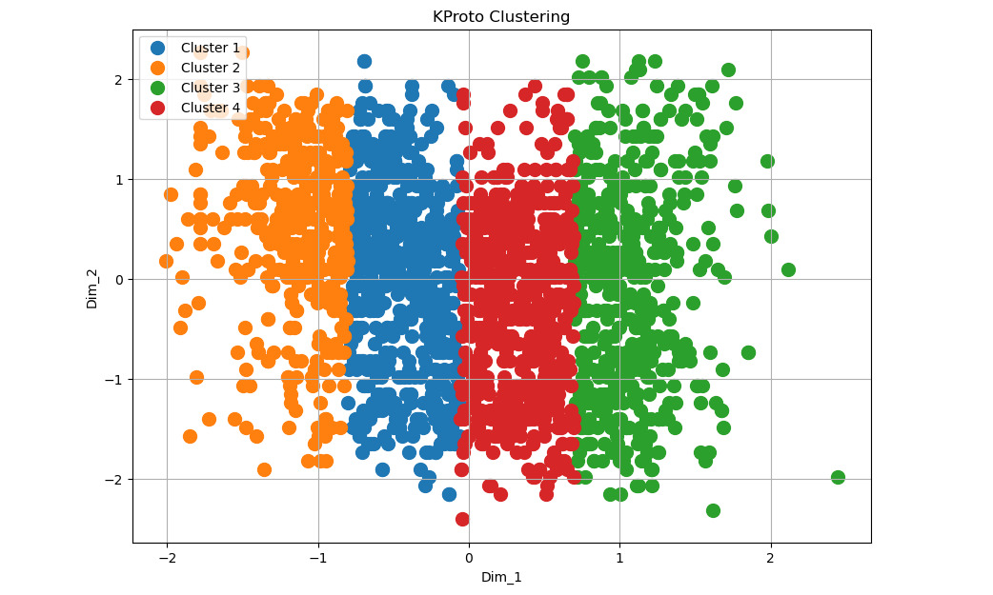
Understanding the Customers on the basis of Demography
Customer Segmentation facilitates insight into customer needs, enabling targeted marketing strategies.
KProto Clustering was utilized for effective customer segmentation.
Through analysis, customers were categorized into four groups based on criteria such as income, marital status, and education.
This segmentation approach enhances the precision of marketing strategies for each identified customer group.
Cluster Visualization

Slide 13
What targeted Marketing Strategies can be developed based on Customer Purchase Patterns?

Slide 14
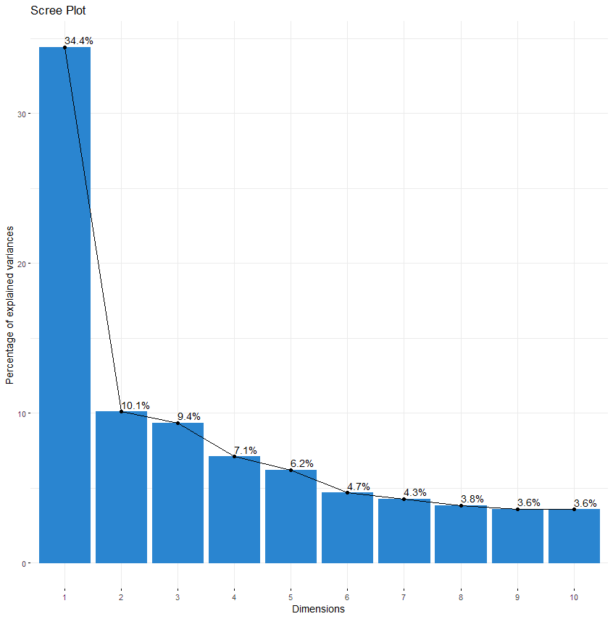



Targeted Marketing on the basis of their purchase pattern
Customer segmentation
Process Overview
Identified Customer Segments
Application
Scree Plot to decide the number of different groups
Identified key patterns in customer behaviour, guiding marketing strategies using PCA.
Culinary Enthusiasts and Shopping Lovers
Responsive Campaign Participants
Youthful Shoppers and Deal Seekers
Personalized Campaigns
Optimized Campaign Timing
Resource Allocation
Understanding and leveraging customer purchase patterns provide a roadmap for developing targeted marketing strategieswhich enhances campaign effectiveness and empowers businesses to navigate the dynamic market landscape with strategic precision.

Slide 15
How do customers respond to our marketing campaigns, and what factors contribute to their acceptance?

Slide 16
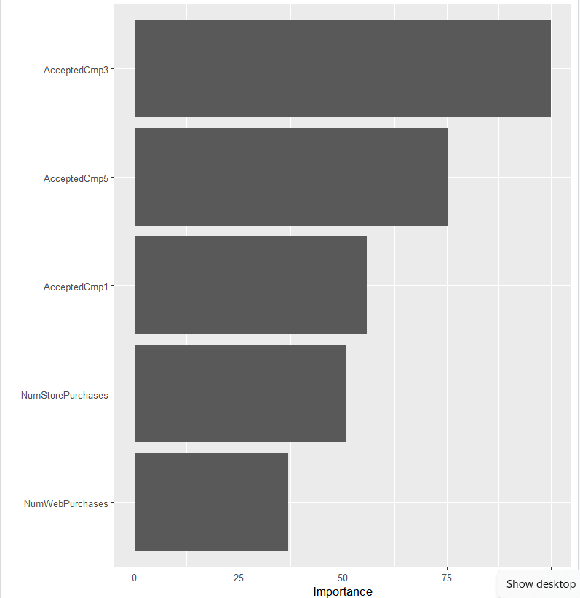

Understanding Customer Acceptance to Marketing Campaigns
 |  | Actual Values
 |  | Positives | Negatives
Predicted Values | Positives | 26 | 74
 | Negatives | 16 | 549
Result Analysis
By running the Logistic Regression model to predict the acceptance of customers to marketing campaigns, we achieved an Accuracy of 86.47%, Sensitivity of 97.17% and a Specificity of 26%
The Confusion Matrix and its key statistics revealed that the model exhibits high accuracy, primarily driven by a high true negative rate
However, there is a notable imbalance, with high sensitivity but low specificity. This suggests a strong ability to identify actual positive responses but challenges in correctly identifying non-responses
Furthermore, the predictor variables AcceptedCmp3, AcceptedCmp5, AcceptedCmp1, NumStorePurchases and NumWebPurchases are the top 5 important predictor variables that influence the response rate to the campaign as seen in from the graph
The above 5 variables have a good Odds Ratio and are also statistically significant as seen in the coefficient table
From this we can infer that the person is most likely to accept the offer in the 3rd marketing campaign
These performance metrics guide marketers in understanding the model's strengths and weaknesses
They also serve as a basis for refining strategies, ensuring a focus on customers most likely to respond positively to campaigns.
Variables of Importance affecting Customer Acceptance
Notes:
This slide will dive into understanding customer acceptance of marketing campaigns. In order to analyze this impact, we employed various statistical testing methods like logistic regression to identify significant factors that influence customer acceptance to marketing campaigns.
In the realm of marketing, it's crucial to identify patterns that influence customer behavior. Hypotheses generated from our analysis hinted at specific purchase behaviors positively influencing responsiveness.
Here, Logistic regression, a powerful tool, was employed to determine the likelihood of a customer responding positively or not to a marketing offer. We ensured the model's robustness by validating assumptions, including the linearity, normality, and the absence of multicollinearity among predictor variables. This model exhibited exceptional strength, with a remarkable 97.17% sensitivity. This means it effectively identifies customers likely to respond positively, providing a solid foundation for targeted and engaging campaigns. However, we noted a challenge in accurately identifying non-responsive customers, reflected in the lower specificity of 26.00%. To enhance marketing efficiency, there is a clear opportunity to refine the model's ability to recognize customers less likely to respond.
Our model's accuracy of 86.47% and precision of 88.12% empower marketers to optimize campaign strategies. Predictor variables such as AcceptedCmp3, AcceptedCmp5, AcceptedCmp1, NumStorePurchases, and NumWebPurchases were identified as top influencers on the response rate to the campaign. These results suggests that customers are most likely to accept an offer in the 3rd marketing campaign. The confusion matrix as seen on the slide dives deeper into the instances where the model correctly or falsely predicted the responsiveness of customers to marketing campaigns.
Further fine-tuning of this model could involve adjusting the model's threshold or incorporating additional features to capture nuanced customer behavior. These performance metrics not only guide marketers in understanding the model's strengths and weaknesses but also serve as a basis for refining strategies. By focusing on customers most likely to respond positively, we can ensure resources are efficiently allocated for maximum impact.
In conclusion, our research provides actionable insights that bridge the gap between theoretical understanding and practical application in the dynamic field of marketing.

Slide 17
How is Customer Response to Marketing Campaign related to the Recency of customer’s Last Purchase?

Slide 18

Delving into Customer’s Last Purchase and Response to Campaigns
The relationship between a customer's response to a marketing campaign and the recency of their last purchase is a critical aspect for marketers. It helps understand if recent purchases influence campaign engagement.
This connection can indicate how likely customers are to respond positively to a marketing effort based on how recently they made a purchase. Understanding this link is pivotal in optimizing marketing strategies, as it informs when to launch campaigns for maximum impact.
For instance, if recent purchases strongly correlate with campaign responses, it suggests that targeting customers shortly after their last purchase might yield better engagement.
Conversely, if there's no strong association, it indicates that other factors besides recency might be more influential in driving campaign responses. This insight allows marketers to time their campaigns effectively and tailor their approach to engage customers more efficiently.
We will analyze this relationship further using Fisher's Exact Test.

Slide 19
Analysis and Outcome
Attribute | P- value
First Marketing Campaign | 0.6574
Second Marketing Campaign | 0.127
Third Marketing Campaign | 0.1614
Fourth Marketing Campaign | 0.3355
Fifth Marketing Campaign | 0.6561
The results show no significant link between Acceptance of marketing campaigns 1,3,4, 5 and the recency of a customer's last purchase.
This proves that the acceptance of the mentioned campaigns is not strongly associated with last purchase timeline
While Acceptance of Marketing Campaign 2 hinted at a possible association , further investigation is required to reach any conclusions.
These results imply that these campaigns might not align optimally with recent purchase behavior. This emphasizes the need to consider factors beyond recency, like campaign content, channels, or preferences, to enhance overall campaign effectiveness.

Slide 20
In what ways do Customer Complaints impact the effectiveness of our Campaigns?

Slide 21
Understanding the impact of complaints on campaigns
Importance of Customer Complaints
Positive
Impact on Reputation
Customer Satisfaction and
Loyalty
Insights for Campaign Optimization
Statistical Analysis and Conclusion
Valuable feedback
Areas for improvement
Addressing complaints enhances brand reputation.
Resolving complaints promptly boots brand image
Positive word of mouth from satisfied customers
Effective resolution increases brand satisfaction
Satisfied customers are more loyal
Highlights areas of improvement
Identify trends in complaints to enhance future marketing strategies.
Used Chi-Square Test
p – value = 1
No relationship between customer ”Complaints” and Responses.
Contingency table
Frequency Distribution
Key Observations
Significance
Predominance of no complaints and no responses.
330 occurrences where complaints are absent, but responses are recorded.
Minimal instances of simultaneous complaints and responses
Common occurrence of no complaints and no responses.
Noteworthy proportion of responses without complaints.
Sparse instances of both complaints and responses.
Foundation for exploring the relationship between complaints and responses.
Sets the stage for statistical analyses (e.g., chi-square tests).

Slide 22

LIMITATIONS
The effectiveness of segmentation and marketing strategies may vary based on specific contexts,
limiting the universality of findings
The choice of statistical tests and libraries employed in the analysis may influence outcomes.
Alternative methods could potentially yield different insights, adding a layer of interpretation
subjectivity
The validity of findings is contingent on the quality and completeness of the dataset. Incomplete or
inaccurate data could introduce biases and affect the robustness of the study's conclusions
The study is confined to the variables under consideration. Unexplored factors may contribute to
customer behavior and campaign responsiveness, suggesting that the comprehensive understanding
of these aspects is subject to the studied variables

Slide 23
FUTURE SCOPE
Future research could focus on the dynamic nature of customer segments, exploring how these
segments evolve over time. This would involve identifying and understanding trends in customer behavior
that may change over different periods.
There is potential for incorporating advanced machine learning algorithms to enhance the accuracy of
segmentation and prediction models. This could involve leveraging sophisticated techniques to uncover
more intricate patterns in customer behavior
Avenues for exploration include conducting sentiment analysis on customer feedback and social media
data. This approach could provide richer insights into customer perceptions, sentiments, and preferences,
offering a more holistic understanding of customer behavior
Future studies might consider conducting longitudinal analyses i.e tracking customer behavior over extended
periods. This approach could offer a more in-depth and nuanced understanding of how marketing strategies
impact customer behavior over time, providing insights into long-term trends and patterns.

Slide 24
CONCLUSION
By leveraging Principal Component Analysis (PCA) and Cluster Analysis, we've identified critical patterns and meaningful customer segments based on key attributes, providing a foundation for tailored marketing approaches.
Logistic regression showcased the predictive power of customer purchasing patterns on campaign responsiveness. This insight allows us to focus efforts on key predictors for more effective targeting.
Fisher's Exact Test has illuminated relationships between campaign acceptances and the recency of customer purchases. Armed with this knowledge, we can strategically time our campaigns for maximum impact.
Contrary to expectations, the Chi-square test revealed that customer complaints have minimal impact on campaign responses. This suggests that addressing other factors, such as purchasing patterns, is more crucial for campaign success.
The overall findings underscore the significance of personalized marketing strategies, emphasizing the need for businesses to adapt to evolving customer dynamics for enhanced campaign success.

Slide 25
REFERENCES
[1] Hosseini, M., & Shabani, M. (2015). New approach to customer segmentation based on changes in customer value. Journal of Marketing Analytics, 3, 110-121.
[2] Gunnarsson, B. R., vanden Broucke, S., & De Weerdt, J. (2019). Optimizing marketing campaign targeting using uncertainty-based predictive modelling. 2019 International Conference on Data Mining Workshops (ICDMW).
[3] Chang, C.-T., Chu, X.-Y. (Marcos), & Tsai, I.-T. (2020). How cause marketing campaign factors affect attitudes and purchase intention. Journal of Advertising Research, 61(1), 58– 77.
[4] Blodgett, J. G., Wakefield, K. L., & Barnes, J. H. (1995). The effects of customer service on consumer complaining behavior. Journal of services Marketing, 9(4), 31-42.
[5] Sultan, F., Rohm, A. J., & Gao, T. (2009). Factors influencing consumer acceptance of mobile marketing: a two-country study of youth markets. Journal of Interactive Marketing, 23(4), 308-320
[6] Saldanha, R. (2020a, May 8). Marketing campaign. Kaggle. https://www.kaggle.com/datasets/rodsaldanha/arketing-campaign/
6

